Slide 1
Phone Marketing Algorithm Analysis
PWC analyst: Xiaofu Chen

Slide 2
Agenda
Model Selection
Feature Importance
Take-aways

Slide 3
Model results
Model | Accuracy Score
XGBoost Classifier | 0.9027
Kneighbor Classifier | 0.8918
Random Forest Classifier | 0.8850
Decision Tree Classifier | 0.8452
Logistic Regression | 0.8256
After tuning, XGBoost Model has the best performance.

Slide 4
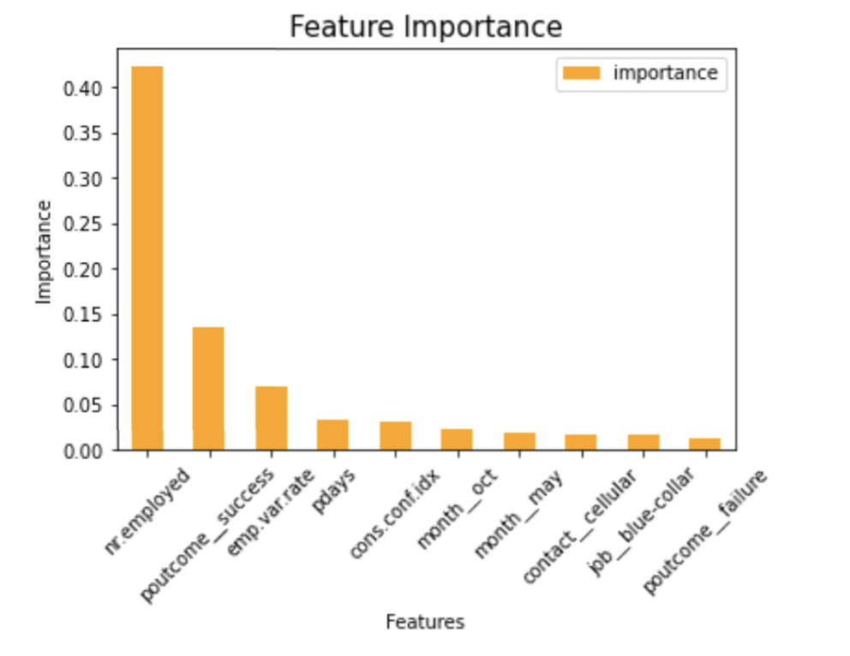
Feature Importance（XGBoost)
nr.employed: the number of employees
poutcome_success: the outcome of the previous marketing campaign is success
Emp.var.rate: employment variation rate (shows importance in all models)

Slide 5
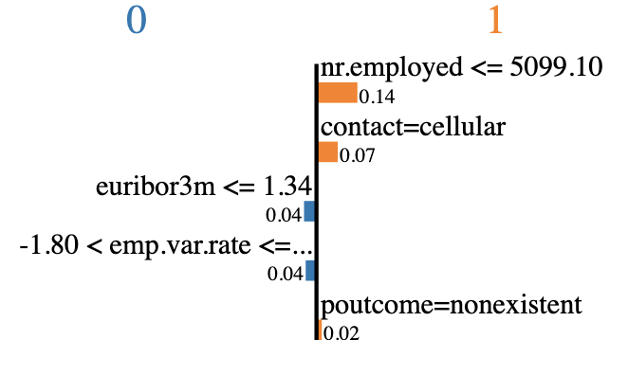
Feature Importance
(For observation #4)
nr.employed: the number of employees
Contact=cellular: contact method is cellular
Euribor3m: euribor 3-month rate
poutcome_nonexistent: the outcome of the previous marketing campaign is not existent
Emp.var.rate: employment variation rate
Prediction result: Yes

Slide 6
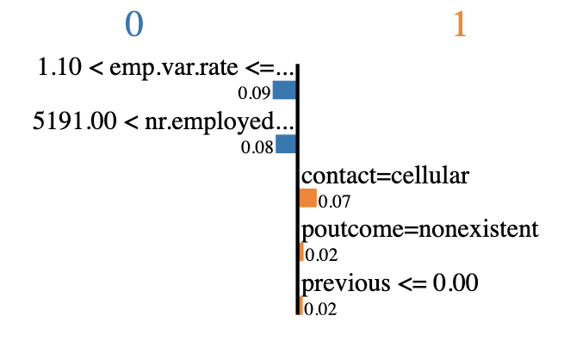
Feature Importance
(For observation #20)
Emp.var.rate: employment variation rate
nr.employed: the number of employees
Contact=cellular: contact method is cellular
poutcome_nonexistent: the outcome of the previous marketing campaign is not existent
Previous: number of contacts performed before this campaign and for this client
Prediction result: No

Slide 7
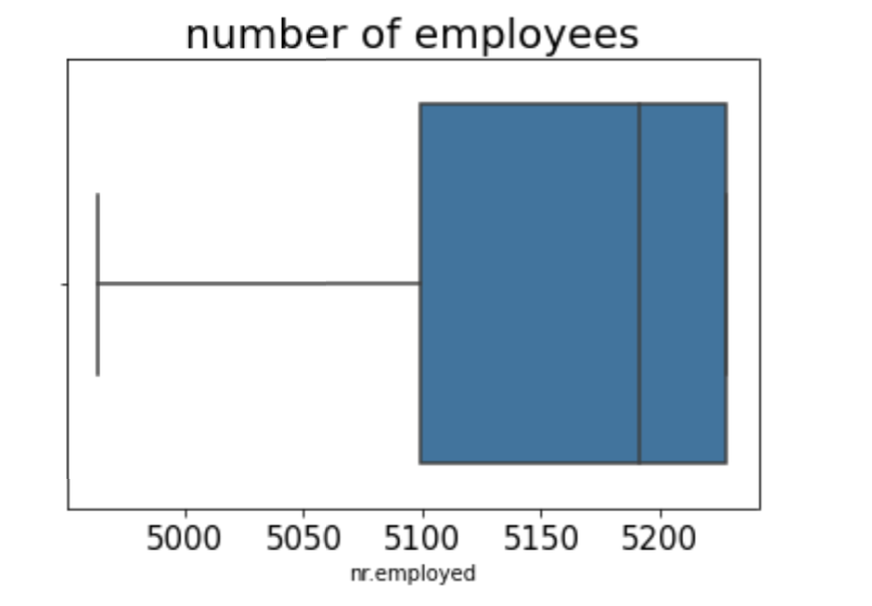
Take-aways
Lower number of employees (<5099) brings positive impact in the model.
However, the mean number in our dataset is 5167.

Slide 8
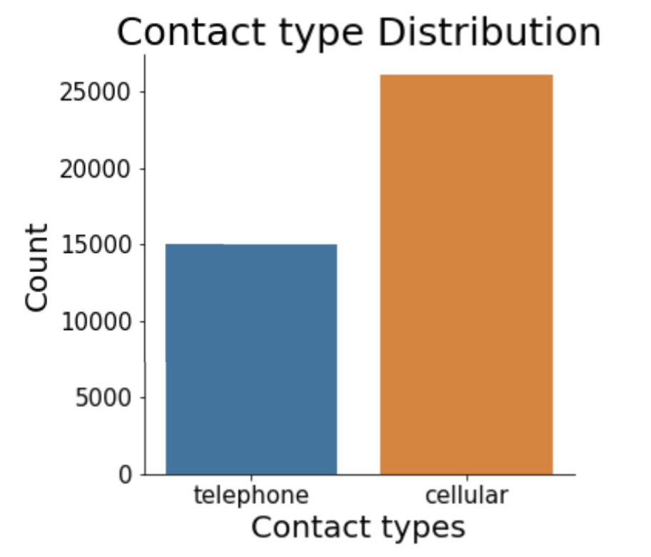
Take-aways
Encourage clients to choose cellular rather than telephone as communication type.

Slide 9
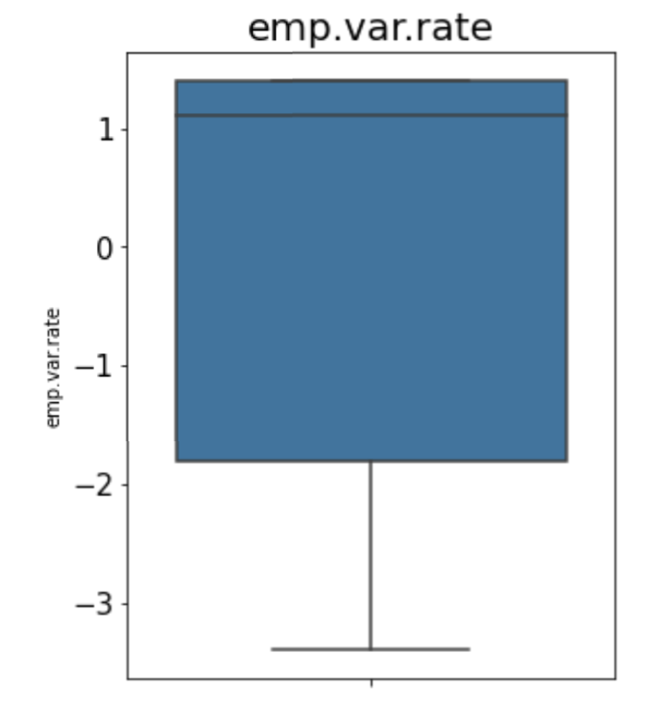
Take-aways
Negative employment variation rate (<-1.8) has positive impacts in our model.
The mean rate is 0.08

